Slide 1
Think Like an Entrepreneur
Tuesday, November 13th, 2012
blackstonelaunchpad.wayne.edu

Slide 2
Funded by the Blackstone Charitable Foundation, the Blackstone LaunchPad opened in September 2010 offering career guidance, resources, and advice to students at Wayne State University.
Our primary mission is to show Wayne State University students that starting a new venture is a legitimate career path and attainable reality.

Slide 3
AVC Kitchens
Krystle Antonio
Motivational Speaker
Pay It Forward Initiative

Slide 4
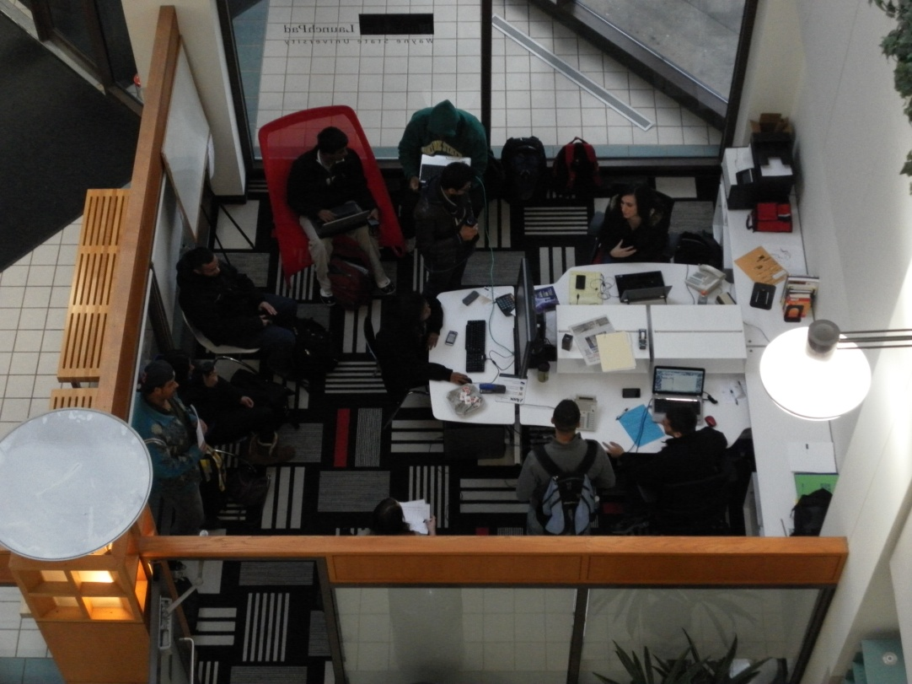
How We Do It
Individual Consultations (VAMs)
Trainings/Workshops/Events
Pop-Up Gallery
Get Launched Social Enterprises
Road Trips to visit Entrepreneurs
Funding
Warrior Fund (6 companies awarded)
Symposiums
Business Competitions
Networking with the Business Community
Venture Coaching

Slide 5
Detroit is Full of It
Mid Michigan Innovation Center
Macomb Incubator
Automation Alley
OU INCubator
Automation Alley
Michigan Life Science and Innovation Center
UM Medical Innovation Center
MI- SBTDC
Innovation Institute at Henry Ford Hospital
D:Hive
Bizdom
SPARK
Tech Town
Tech
ARB
Next Energy

Slide 6
Intrapreneurs are Opportunists
Your department asks for someone to run a new program; what do you do?
There is an obvious problem with a procedure – you have a new supervisor who asks for input; what do you do?
You see a customer not being served well or at all; what do you do?

Slide 7
Cynthia Finger-Hoffman,
Serial Entrepreneur, M.B.A.
B.S. University of Central Florida, Education and Business 1998
M.B.A. Wayne State University, Business Management 2011
Chicago Coffee Company LLC
ie: ideas +exhibits llc
Just Like Home 24/7 Child Care LLC
Bounce 3 Inflatable Rentals LLC
Green Start Batteries (student venture)
Clean Emission Fluids, Inc. (General Manager)
Blackstone LaunchPad, Wayne State University

Slide 8
Entre/Intra/Crazy - PRENEUR
Do you ever sit in a meeting thinking – “There is a better way to make this decision.”
Have you ever championed a new process or procedure in the workplace?
Do you reorganize rooms or spaces because it will make it easier to do things?
When you see an unusual product do you ask how will it make $$$?

Slide 9
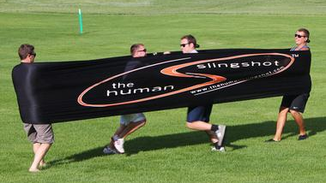
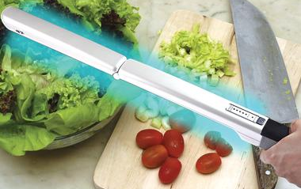
Innovation
Creativity
Logical
Progressive
Efficiency
Notes:
Do any of these words ring true for you? Do you like the sound of them?

Slide 10
Intra - PRENEUR
Coined by Gifford Pinchott in 1986
“Intrapreneur" refers to someone who possesses entrepreneurial skills and uses them within a company, instead of using them to launch a new business.
Intrapreneurs—also called corporate entrepreneurs—can help established companies implement innovative policies and procedures or introduce innovative products or services.
Intrapreneurship differs from entrepreneurship in that intrapreneurs constantly must overcome barriers and negotiate obstacles and have opportunities to work with greater financial, technological, and human resources offered by an established company. In contrast, entrepreneurs largely work independently and often lack the resources of large companies.

Slide 11
ASSESSMENT
Take your time, think about each statement.

Slide 12
LifeStyle Assessment
If your score is 63 or higher, you have a good understanding and tolerance for the impacts that change can have on your life.
Your score reveals that you are flexible enough to take on the challenges and uncertainties of beginning a new business, process or program.
This checklist has been reprinted from the NxLeveL Guide for Business Startups with permission from the NxLeveL Training Network.

Slide 13
Personal Assessment
A score between 63 and 100 points indicates you are well on your way to having the right mix of personal skills to weather the challenges of change and ambiguity.
You enjoy setting your own goals and achieving them and you are comfortable with taking some risks.
This checklist has been reprinted from the NxLeveL Guide for Business Startups with permission from the NxLevel Training Network.

Slide 14
APPLICATION – work and home
What area do you want to work on?
WHY?
What do you have to lose?

Slide 15
Intrapreneurs are Opportunists
Your department asks for someone to run a new program; what do you do?
There is an obvious problem with a procedure – you have a new supervisor who asks for input; what do you do?
You see a customer not being served well or at all; what do you do?

Slide 16
Questions???
Cynthia Finger-Hoffman
313.577.1533
cynthiafinger@wayne.edu

Slide 17
INTRAPRENEURIAL 10 Commandments
Seek approvals creatively: ask managers for small decisions, to keep the importance of the decisions minimal and to help ensure approval.
Find and use allies: recruit the support of employees within the company, especially ones with knowledge and skills relevant to the innovation as well as ones with considerable influence in the company.
Notes:
According to Howard Oden in Managing Corporate Culture, Innovation, and Intrapreneurship identified a number of strategies or techniques for intrapreneurs, which allow them to be innovative and creative while functioning inside a corporation. Wall Street Journal columnist Timothy D. Schellhardt included some of these techniques in his article "Small Business: David in Goliath," where he referred to them as part of his "Intrapreneur's Ten Commandments"

Slide 18
INTRAPRENEURIAL 10 Commandments
Establish coalitions: intrapreneurs can realize their goals by forming coalitions to support their innovations. Coalitions involve both supportive coworkers and managers or executives.
Persuade management to be flexible: with the help of customers, allies, and coalitions, intrapreneurs should strive to change rigid company policies in order to facilitate innovation.
Notes:
Oden identified a number of strategies or techniques for intrapreneurs, which allow them to be innovative and creative while functioning inside a corporation. Wall Street Journal columnist Timothy D. Schellhardt included some of these techniques in his article "Small Business: David in Goliath," where he referred to them as part of his "Intrapreneur's Ten Commandments":

Slide 19
INTRAPRENEUR 10 Commandments
Share credit: intrapreneurs should recognize all those who participate in an innovative project to promote further collaboration in the innovation process.
Control time expectations: keep projects low profile until research and development is completed and the innovation is nearly ready for the market.
Notes:
Oden identified a number of strategies or techniques for intrapreneurs, which allow them to be innovative and creative while functioning inside a corporation. Wall Street Journal columnist Timothy D. Schellhardt included some of these techniques in his article "Small Business: David in Goliath," where he referred to them as part of his "Intrapreneur's Ten Commandments":

